Slide 1
Generative Learning algorithms

Slide 2

Two Algorithms
discriminative learning algorithms
Generative learning algorithms
Algorithms that try to learn p(y|x) directly (such as logistic regression)
Algorithms that try to learn mappings directly from the space of inputs X to the labels {0, 1}
To model p(x|y) and p(y)
Actually, if were calculating p(y|x) in order to make a prediction, then

Slide 3
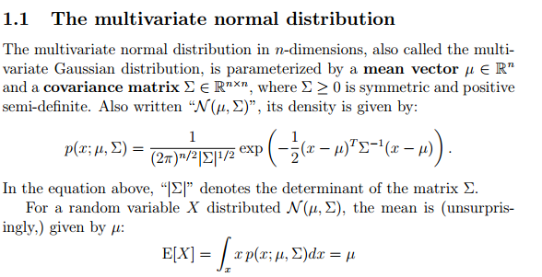

Gaussian discriminant analysis

Slide 4
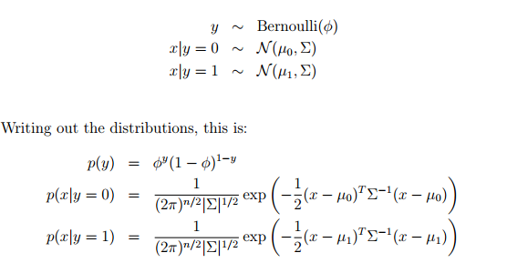

Slide 5
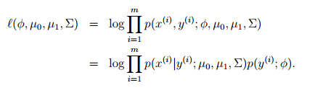
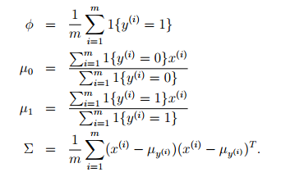

Slide 6
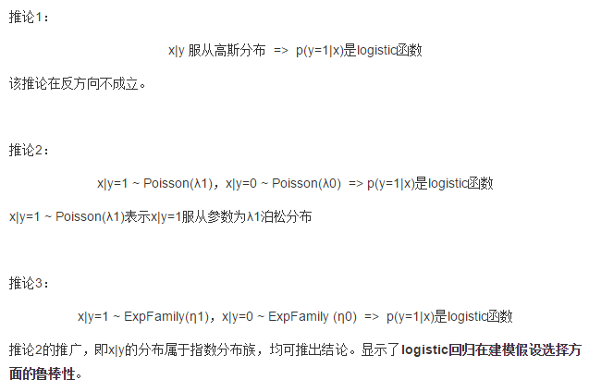
Discussion: GDA and logistic regression

Slide 7
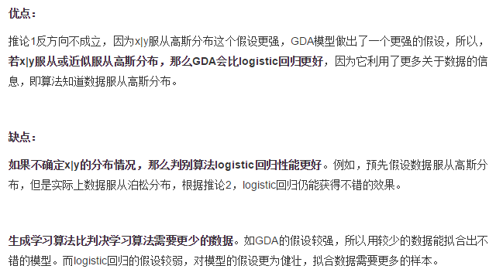

Slide 8
In the limit of very large training sets, GDA will be a better algorithm than logistic regression
Logistic regression will also work well on Poisson data; But if fit Gaussian distributions to such non-Gaussian data—then the results will be less predictable, and GDA may (or may not) do well
GDA makes stronger modeling assumptions, and is more data efficient (requires less training data to learn “well”) when the modeling assumptions are correct or at least approximately correct.
Logistic regression makes weaker assumptions, and is significantly more robust to deviations from modeling assumptions.
In practice logistic regression is used more often than GDA

Slide 9
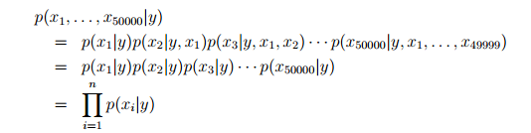
Naive Bayes
assume that the xi’s are conditionally independent given y. This assumption is called the Naive Bayes (NB) assumption, and the resulting algorithm is called the Naive Bayes classifier.

Slide 10
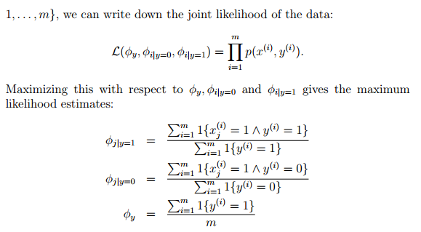

Slide 11
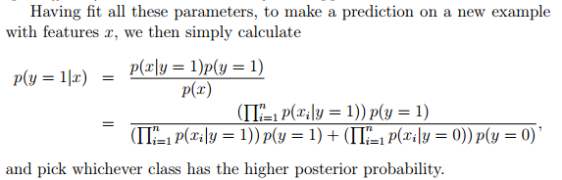


Slide 12

Laplace smoothing
Stating the problem more broadly, it is statistically a bad idea to estimate the probability of some event to be zero just because you haven’t seen it before in your finite training set.

Slide 13
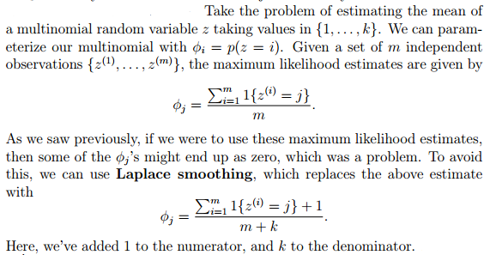

Slide 14
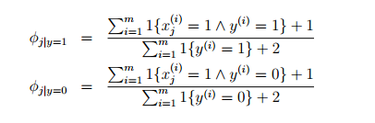

Slide 15
Event models for text classification
In the specific context of text classification, Naive Bayes as presented uses the what’s called the multi-variate Bernoulli event model
Here’s a different model, called the multinomial event model

Slide 16
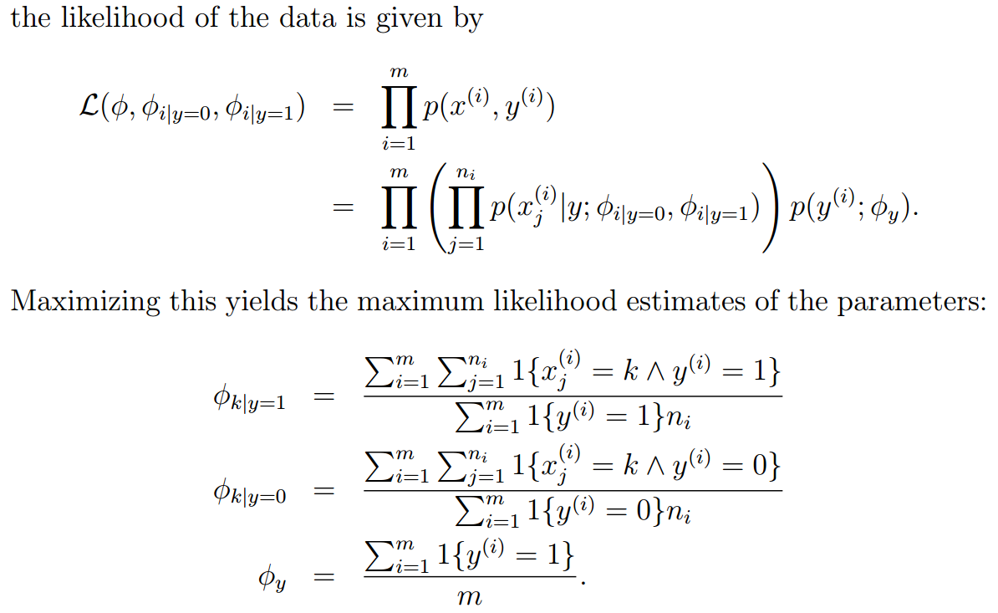

Slide 17
While not necessarily the very best classification algorithm, the Naive Bayes classifier often works surprisingly well. It is often also a very good “first thing to try,” given its simplicity and ease of implementation.

